Slide 1
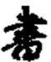
Original Network trained for 4 output classes
Section to be retrained
Bottleneck layer
Retrained last section now with 8 outputs
New output layer with more outputs

Slide 2
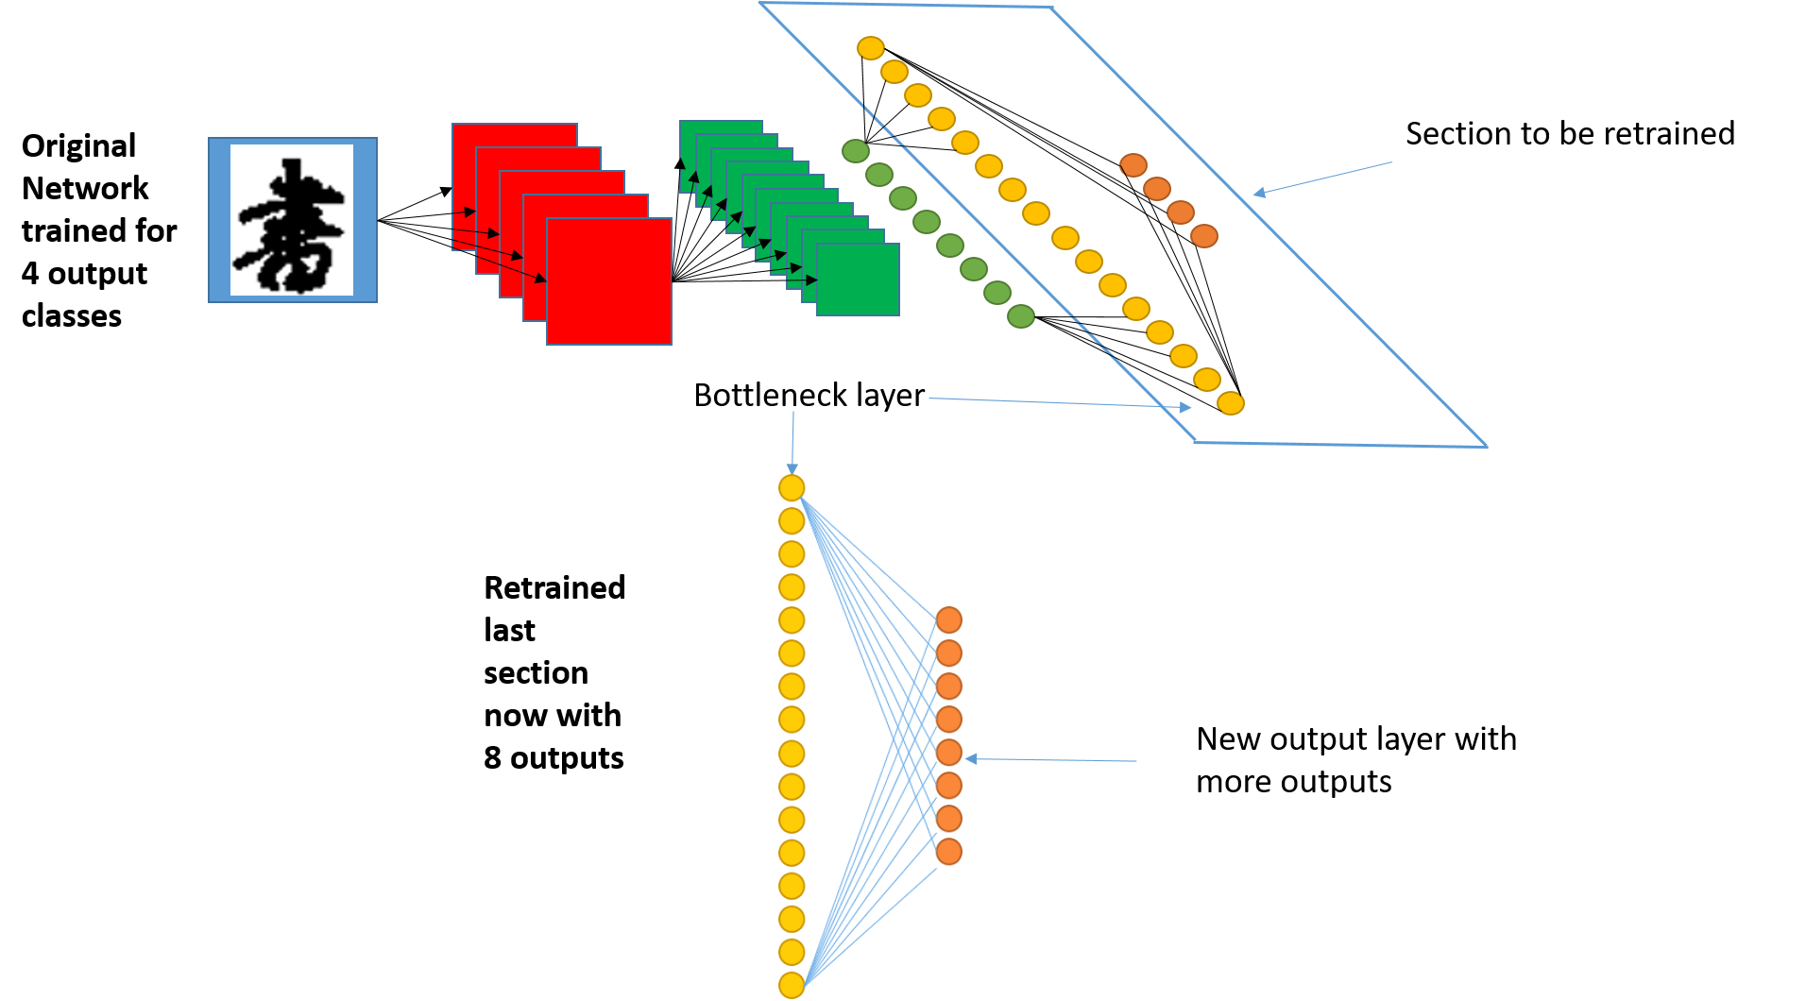
Transfer Learning
Neural network initially trained to identify a few different Chinese characters
Final layer is retrained to have more outputs
The network can identify a larger number of Chinese characters.
This process reduces training time and can increase accuracy.

Slide 3
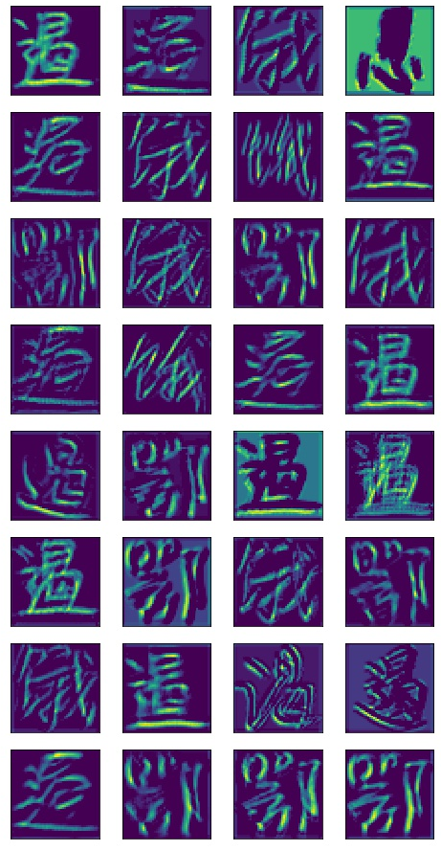
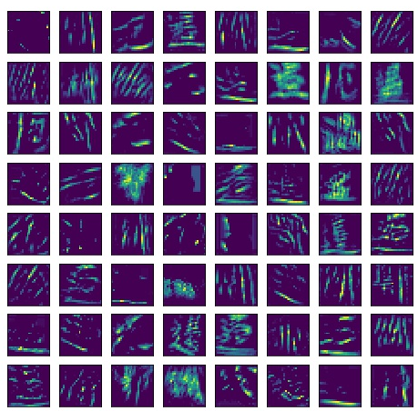
Qualitative Results – Feature Maps
Images display the outputs from the convolutional layers.
The images show what features the network is extracting from the network.
These provide a qualitative measure of how well the network is trained.
Lots of activated neurons indicates a well trained network.
1st layer activations
2nd layer activations

Slide 4
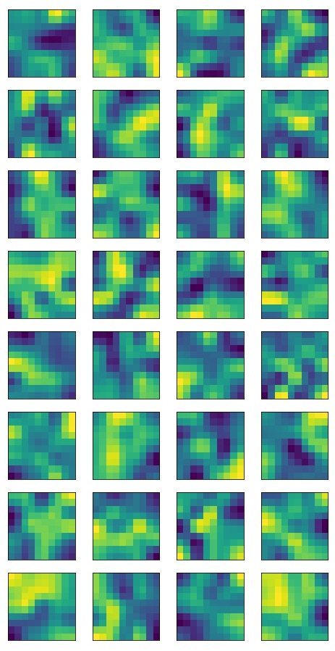
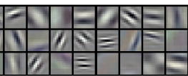
Qualitative Results – Weights
The weights display the shapes that the network is looking for in that layer.
The image classifier filters below are smooth and detect edges.
Our weights appear more random, possibly because we are not classifying images of objects.
Image displaying the weights of the 32 kernels in the first layer of the CNN.
Image displaying 24 of the weights from the first layer of a CNN trained as an ImageNet classifier.
(Krizhevsky, A., Imagenet classification with deep convolutional neural networks, 2012)

